Slide 1
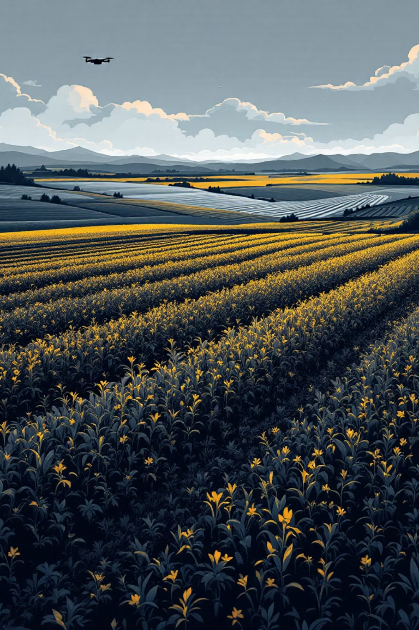
AgroSensi AI
Smart Agriculture using Deep Learning for Soil Classification & Vegetation Segmentation

Slide 2
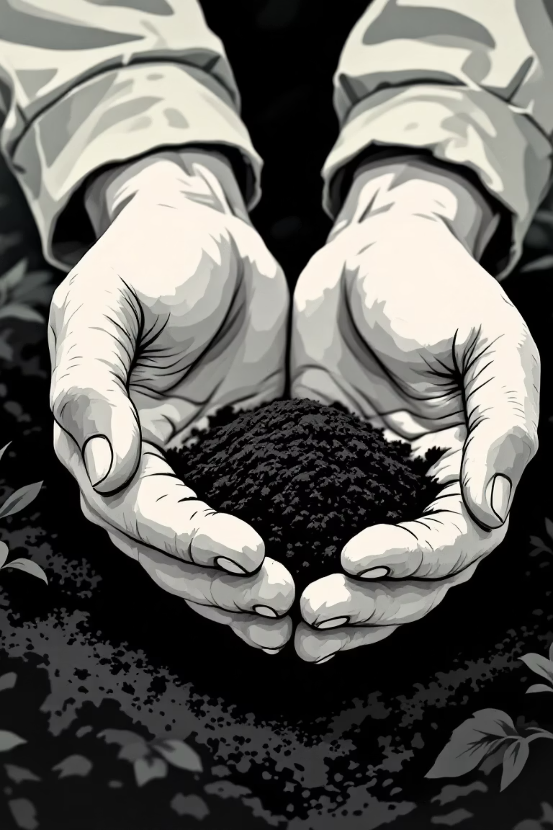

CHALLENGE
The Agricultural Intelligence Gap
Current Reality
The Opportunity
Manual soil and vegetation inspection is labor-intensive, time-consuming, and prone to human error. Farmers often lack access to real-time, data-driven insights that could transform their decision-making and crop yields.
Automated, AI-powered analysis offers unprecedented accuracy in soil classification and vegetation monitoring. By leveraging deep learning, we can deliver instant, actionable insights that empower farmers to optimize their operations.
Traditional methods can't scale with modern agricultural demands, leaving productivity gains on the table.
The future of agriculture is intelligent, automated, and accessible.

Slide 3






TECHNICAL OVERVIEW
Intelligent Processing Pipeline
AgroVision AI transforms raw field imagery into actionable agricultural intelligence through a sophisticated six-stage deep learning pipeline.
Image Upload
Capture and submit field imagery
Preprocessing
Normalize and enhance image quality
Soil Classification
ResNet50 CNN analysis
Vegetation Segmentation
YOLOv8 coverage mapping
Visualization
Grad-CAM explainable AI
Report Generation
Comprehensive PDF output

Slide 4
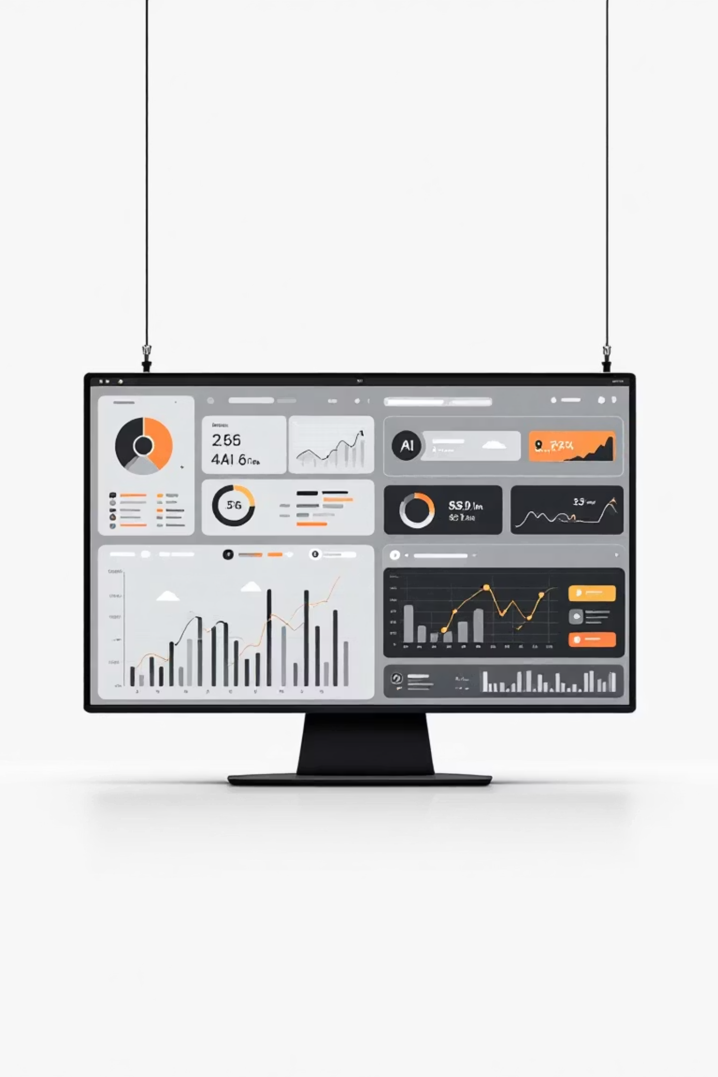




Powered by Industry-Leading Technology
Core Framework
Python & TensorFlow
Advanced machine learning capabilities with optimized performance for agricultural data processing and model training.
Computer Vision
OpenCV & YOLOv8
State-of-the-art image processing and real-time object detection for precise vegetation segmentation and analysis.
User Interface
Streamlit Platform
Intuitive web-based deployment enabling farmers to access AI insights from any device, anywhere in the field.
Data Visualization
Matplotlib & Plotly
Interactive, publication-ready visualizations that transform complex data into clear, actionable agricultural intelligence.

Slide 5






INNOVATION
A Comprehensive AI-Powered Platform
Web-Based Access
Soil Prediction
Vegetation Mapping
Deploy anywhere with cloud-powered intelligence accessible from desktop or mobile devices
Multi-class classification with confidence scores for precise soil type identification
Pixel-perfect segmentation delivers accurate coverage analysis and health monitoring
Visual Overlay
Comprehensive Reports
Intuitive overlay visualization combines soil and vegetation data for holistic field understanding
Generate detailed PDF reports with insights, visualizations, and actionable recommendations

Slide 6
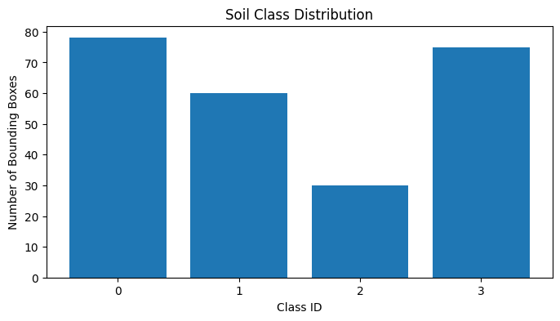
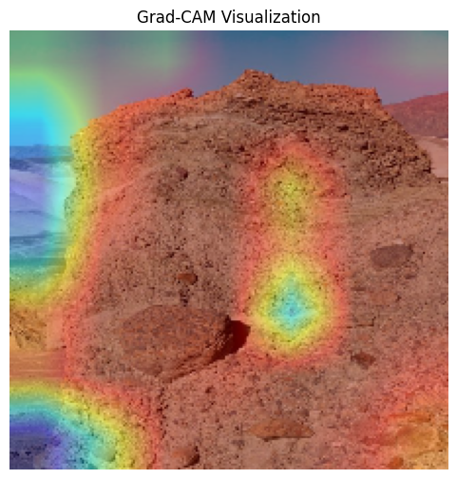
Actionable Insights Through Advanced Visualization
Soil Classification Confidence
Explainable AI
Our ResNet50 model delivers precise soil type predictions with transparent confidence metrics, enabling farmers to make informed decisions about crop selection and soil amendments.
Grad-CAM heatmaps reveal exactly which image features drive our predictions, building trust through transparency and enabling agronomists to validate AI decisions.
Vegetation Segmentation: Binary masks and overlay images provide precise vegetation coverage estimates, helping farmers monitor crop health, identify problem areas, and optimize irrigation strategies.

Slide 7
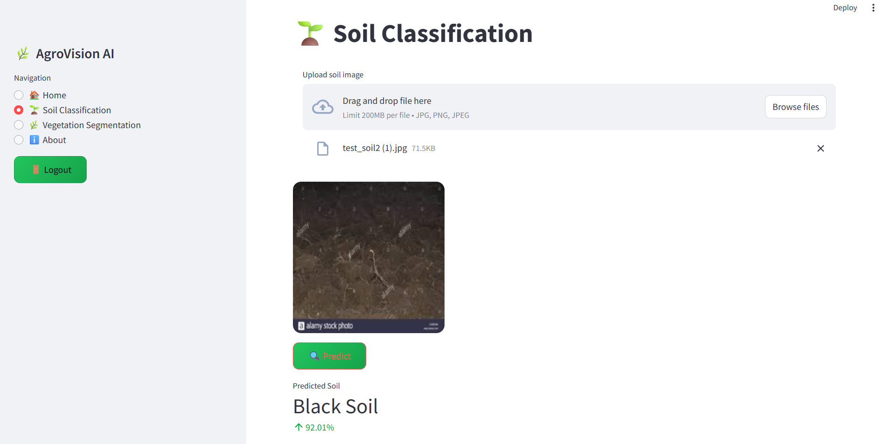

Slide 8
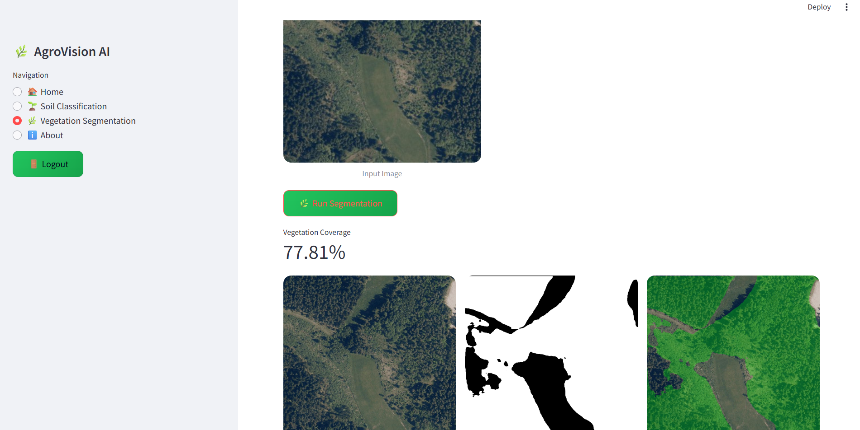
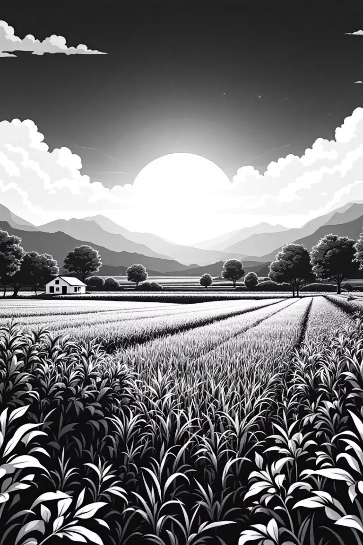

IMPACT
Transforming Agriculture Through AI
94%
87%
10x
Classification Accuracy
Segmentation Precision
Faster Analysis
Precise soil type identification powered by deep learning
Automated processing eliminates manual inspection delays
Reliable vegetation coverage estimation for crop monitoring
Building Trust with Explainable AI
Production-Ready & Scalable
Our platform is built for real-world deployment with a scalable architecture that grows with your operation. From small farms to enterprise agriculture, AgroVision AI delivers consistent performance.
Grad-CAM visualizations and confidence scores demystify AI decisions, empowering farmers to trust and act on our insights. Transparency drives adoption and improves agricultural outcomes.

Slide 9
Live Demo – https://archilogicalmappingui-ghgvrpkd29qhwrgmcerkyo.streamlit.app/
Github Demo - https://github.com/ShubhamS2005/AIDriven-Archaeological-Site-Mapping

